Slide 1

Final Review Of Mini Project
On
IMPACT ANALYSIS OF REAR UNDER RUN PROTECTION DEVICE(RUPD)
Presented By :
B.SUSMITHA 17481A0309
CH.ESWAR 17481A0317
A.BHOGESH 18485A0317
D.SRI KRISHNA 18485A0319
Under the Guidance of
Sri A. Rajesh
Assistant professor
GUDLAVALLERU ENGINEERING COLLEGE
(An Autonomous Institute with Permanent Affiliation to JNTUK, Kakinada)
SESHADRI RAO KNOWLEDGE VILLAGE, GUDLAVALLERU
DEPARTMENT OF MECHANICAL ENGINEERING

Slide 2
Abstract:
This project concentrates on studying, modeling and analysis of Rear Under Run Protection Device (RUPD) under crashing status. The prime objective is to improve the safety of the car and the occupants by designing the RUPD. The selection of material and the two major factors for impact energy absorption during a crash. It is important to know the material, mechanical properties and failure conditions during the impact. Under-running of non commercial vehicle is one of the important parameters to be considered during design, optimization and development of heavy commercial vehicle chassis.

Slide 3
INTRODUCTION :
Many people get injured during under ride accidents. Under ride occurs when a small non commercial vehicle goes under the heavy commercial vehicle either from the front or rear or side. During such accidents the passenger compartment of the small vehicle strikes the chassis of the heavy vehicle causing severe injuries to passenger in the smaller vehicle. Under ride accidents are of three different types namely front, side and rear under run accidents. To avoid such accidents an under run protection device has to be installed on the heavy good vehicle which would prevent the passenger of the small vehicle from getting fatal injuries.

Slide 4
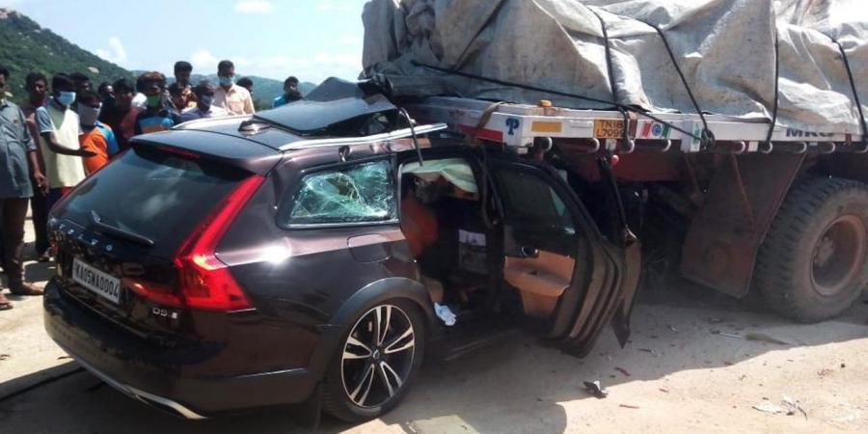
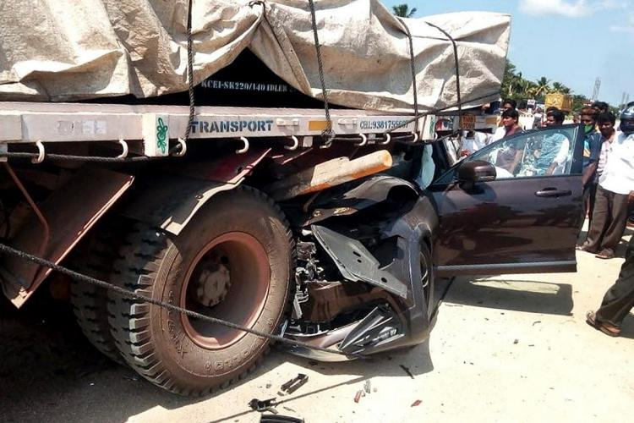
Effects Of Rear Under -run

Slide 5
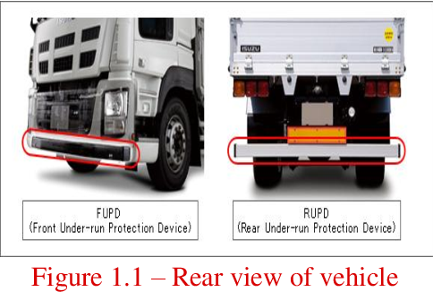
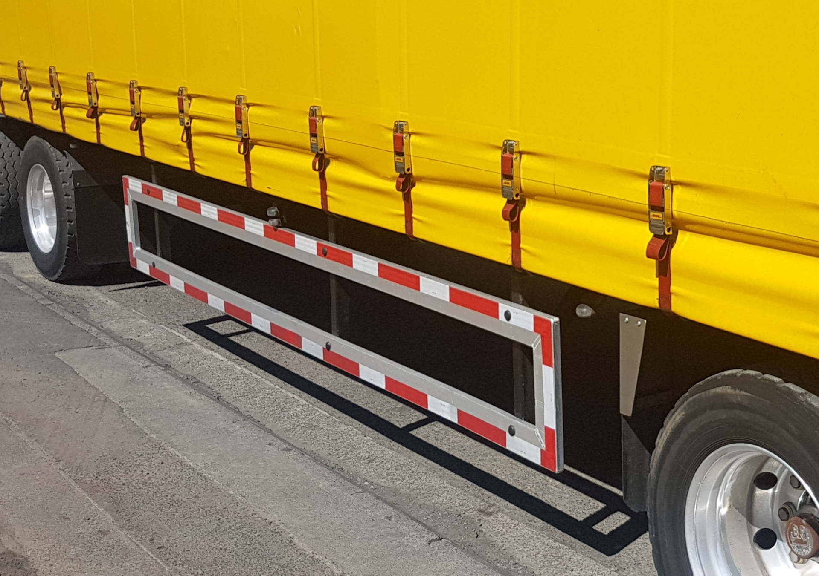
Types of Under-run devices
Side Under-run Device

Slide 6
LITERATURE REVIEW
1. Kumar Bohidar and team formulated head on collision contribute serious accidents which causes driver car safety performances can work effectively by providing fatalities. The un FUPD to the heavy trucks. The trucks with UPD can reduce the car driver fatalities by 40 %. In India, for Front Unde-run ledger Protection Device. IS 14812:2005 regulation is required in for the trucks to meet the safety requirement to protect under running of the passenger car.
2. Mr. George Joseph’s objective of the study, one under ride protection device for a rear under ride accident was designed and its performance compared. A quasi static test was performed on guard to test the strength and energy absorption capacity by withstanding the applied loads. All the constrained and boundary condition used for the study worked well. Nearly six designs were studied and run simulation to study the effectiveness of each guard and results were plotted.

Slide 7
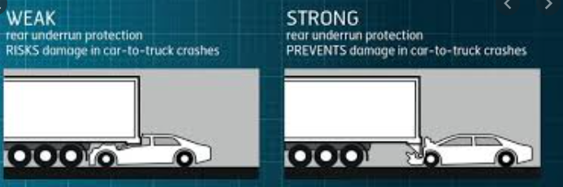
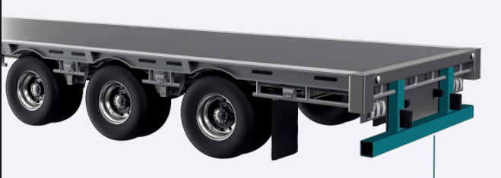
Rear Under-run Protection Device

Slide 8
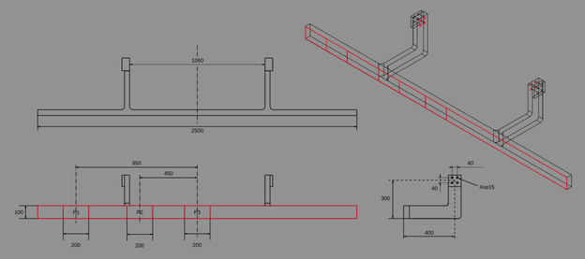
Dimensions
Top view
Isometric view
Front view
Side view
All Dimensions are in MM

Slide 9
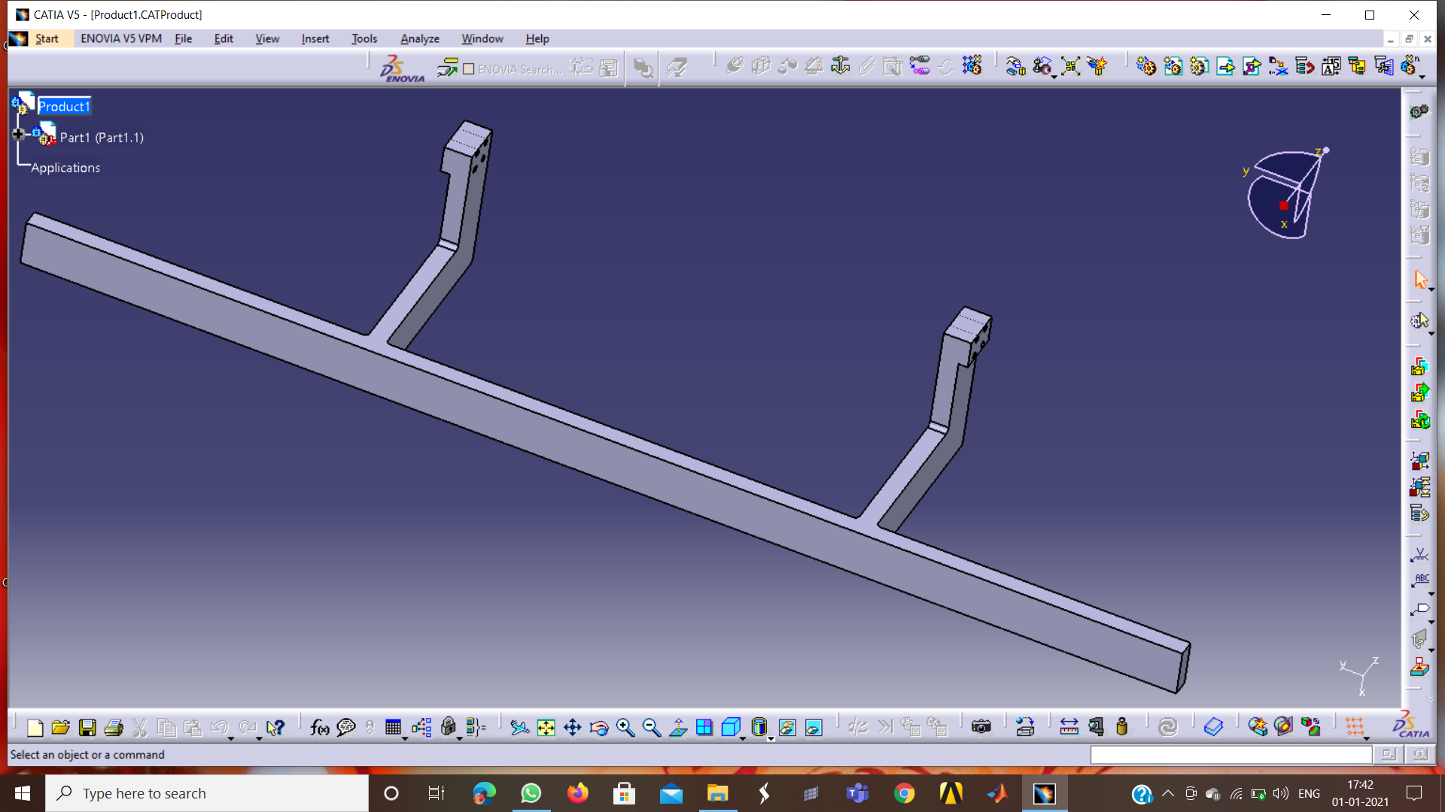
RUPD model designed by using CatiaV5

Slide 10
Materials Used
Sl. no | Material | Reinforcement | Density | Poisson ratio | Youngs modulus
1. | Aluminium (Al) | Silicon Carbide(SiC) | 2.95-3.00(g/cm^3) | 0.35 | 90(Gpa)
2. | Structural steel |  | 7.850(g/m^3) | 0.3 | 215(Gpa)
3. | Stainless Steel |  | 7.48-7.95(g/m^3) | 0.265 | 190(Gpa)

Slide 11
Explicit dynamic analysis

Slide 12
Explicit dynamics:
The Ansys explicit dynamics suite enables you to capture the physics of short duration for products that undergo highly non-linear, transient dynamics forces.
The explicit solution method can handle geometries with complex nonlinear contact that may causes difficulty with the implicit solver in Ansys mechanical.
Explicit uses explicit time integration to solve the equations of motion.
Explicit easily handless the response of materials from impact, high pressure and other forms of loading that result in deformation failure and fragmentation.

Slide 13
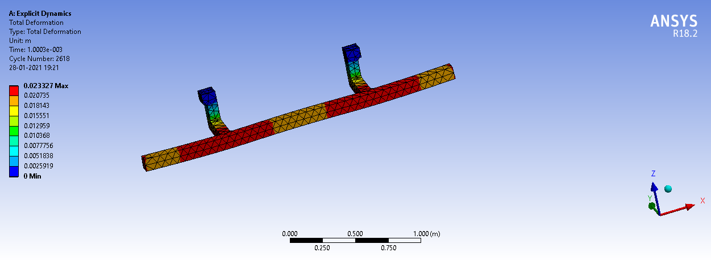
At 72Km/Hr(20m/s) for Structural Steel
Total Deformation:

Slide 14
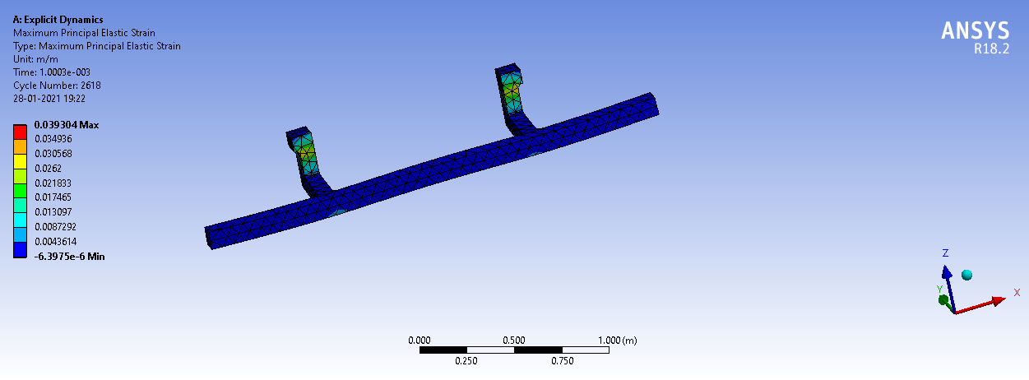
Maximum Principal Elastic Strain

Slide 15
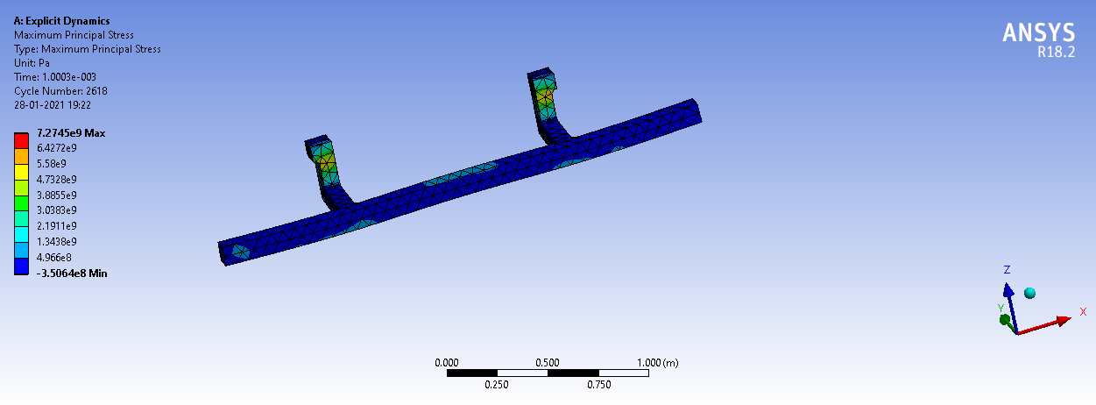
Maximum Principal Stress

Slide 16
At 72Km/Hr(20m/s) for Stainless Steel
Total Deformation

Slide 17
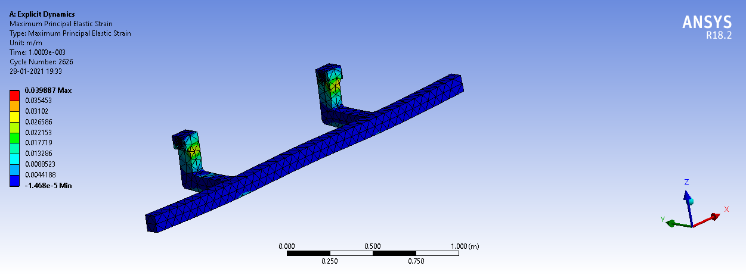
Maximum Principal Elastic Strain

Slide 18
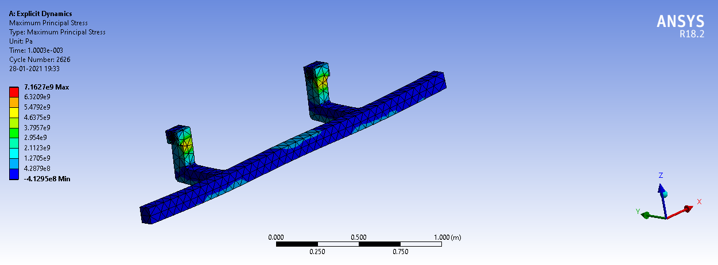
Maximum Principal Stress

Slide 19
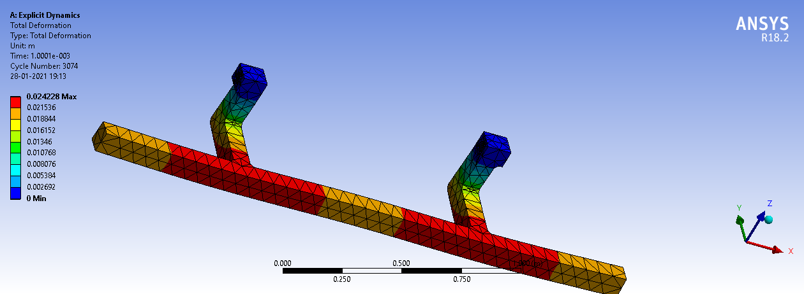
At 72Km/Hr(20m/s) for Al-Sic
Total Deformation

Slide 20
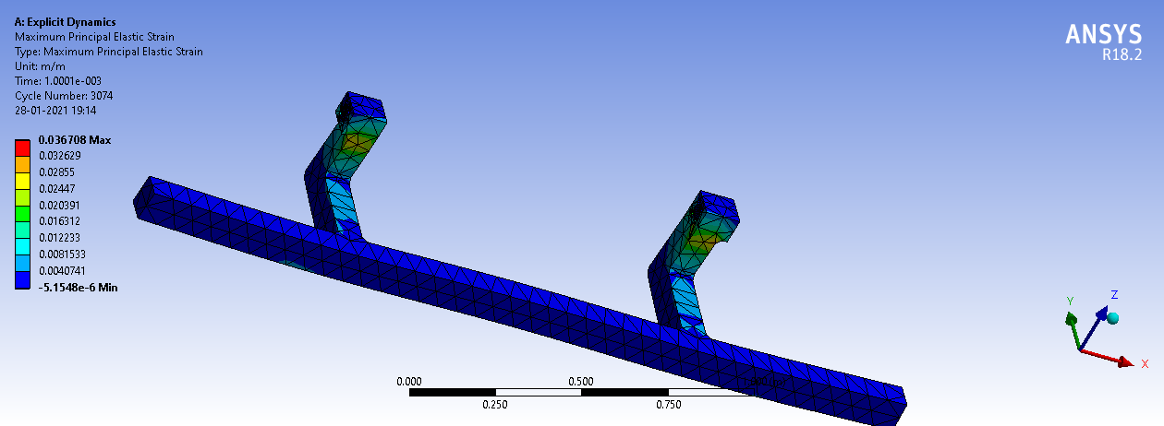
Maximum Principal Elastic Strain

Slide 21
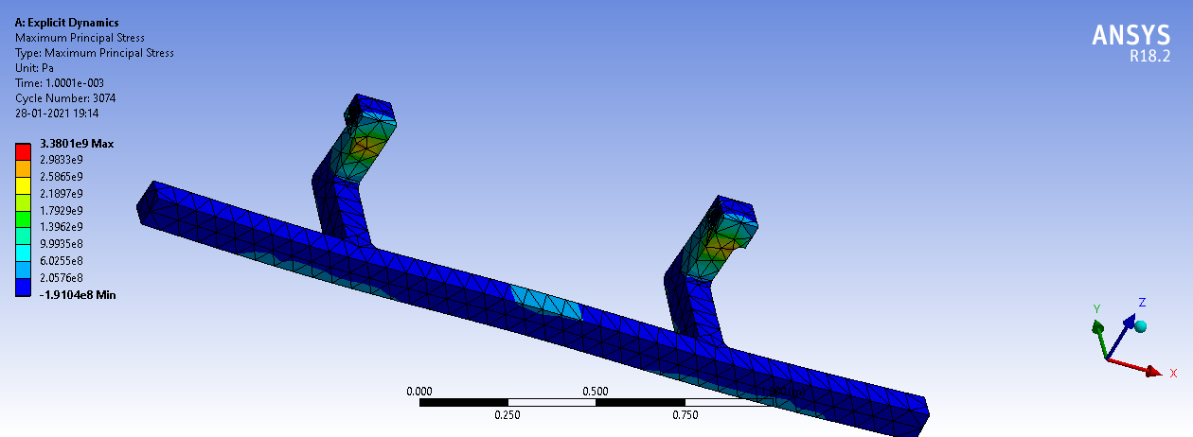
Maximum Principal Stress

Slide 22

At 90Km/Hr(25m/s) for Structural Steel
Total Deformation

Slide 23
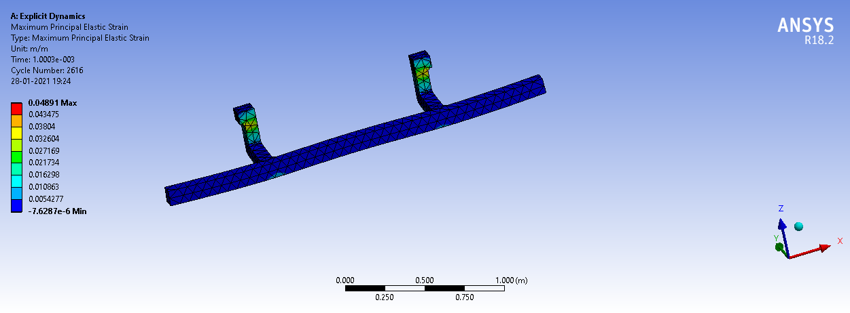
Maximum Principal Elastic Strain

Slide 24

Maximum Principal Stress

Slide 25
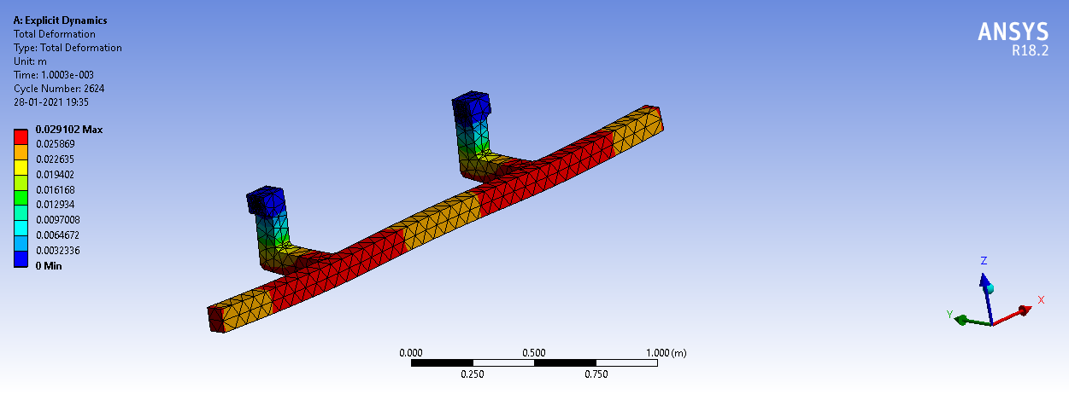
At 90Km/Hr(25m/s) for Stainless Steel
Total Deformation

Slide 26

Maximum Principal Elastic Strain

Slide 27

Maximum Principal Stress

Slide 28

At 90Km/Hr(25m/s) for Al-Sic
Total Deformation

Slide 29

Maximum Principal Elastic Strain

Slide 30

Maximum Principal Stress

Slide 31

At 108Km/Hr(30m/s) for Structural Steel
Total Deformation

Slide 32

Maximum Principal Elastic Strain

Slide 33

Maximum Principal Stress

Slide 34

At 108Km/Hr(30m/s) for Stainless Steel
Total Deformation

Slide 35

Maximum Principal Elastic Strain

Slide 36

Maximum Principal Stress

Slide 37
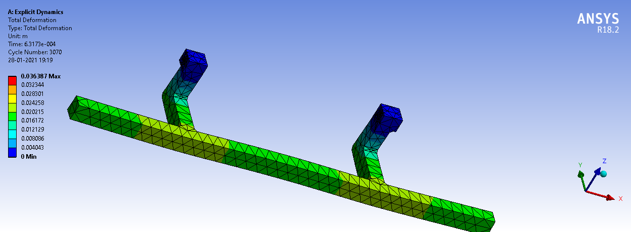
At 108Km/Hr(30m/s) for Stainless Steel
Total Deformation

Slide 38

Maximum Principal Elastic Strain

Slide 39

Maximum Principal Stress

Slide 40
Comparison of results
 | Velocity
Material | 72Km/Hr(20m/s) |  |  | 90Km/Hr(25m/s) |  |  | 108Km/Hr(30m/s)
 | Total Deformation(m) | Maximum principal elastic strain (m/m) | Maximum Principal Stress (Pa) | Total Deformation(m) | Maximum principal elastic strain (m/m) | Maximum Principal Stress (Pa) | Total Deformation(m) | Maximum principal elastic strain (m/m) | Maximum Principal Stress (Pa)
Structural steel | 0.023327 | 0.039304 | 7.2745e9 | 0.029173 | 0.04891 | 9.0492e9 | 0.035023 | 0.058408 | 1.08031e10
Stainless Steel | 0.023264 | 0.039887 | 7.1627e9 | 0.029102 | 0.049687 | 8.9191e9 | 0.039494 | 0.059398 | 1.0658e10
Al-SiC | 0.024228 | 0.036708 | 3.3801e9 | 0.030302 | 0.045881 | 4.2253e9 | 0.036387 | 0.055038 | 5.0694e9

Slide 41
Conclusions:
The Rear Under-run Protection Device(RUPD) is designed and
analysed for the Total deformation, Stress, and Strain individually
for the three different materials and for three different velocities by
using Explicit Dynamics tool in Ansys work bench18.2.
On comparing the three materials the total deformation for the
three materials is approximately equal.
Maximum Principal Elastic Strain is less in Al-SiC when compared
to Structural Steel and Stainless Steel.
Maximum Principal Stress is less in Al-SiC when compared to
Stainless Steel.
Hence using Al-SiC material for the manufacturing of the Rear
Under-run Protection Device (RUPD) is more efficient camparatively.

Slide 42
References:
Bjornstig J, Bjornstig Ulf, Eriksson A, “Passenger car collision
fatalities-with special emphasis on collision with heavy vechicles”,
Accident Analysis and Prevention 2008, P 158-166.
Kaustubh Joshil, T.A.Jadhav2, Ashok Joshi3, Finite Element Analysis of Rear Under-Run Protection Device (RUPD) for Impact Loading.
International Journal of Engineering Research and Development ISSN:2278-067X, Volume 1, Issue 7 (June 012), PP.19-6, www.ijerd.com

Slide 43


